Slide 1
Integrating AI2THOR and Soar
Jim Beyer
Nathan Glenn
Notes:
You have 20s per slide.

Slide 2
AI2THOR
Allen Institute for AI
Physics simulator, AI research environment written in Unity/C#
Controlled via Python over HTTP
Symbolic actions
Object states

Slide 3
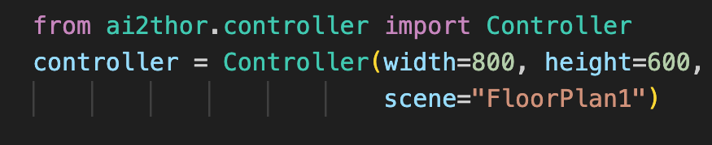
Notes:
Start by creating a Controller object.
Here we specify the scene and the Unity window size.
This starts the unity executable and creates an HTTP connection to it.

Slide 4
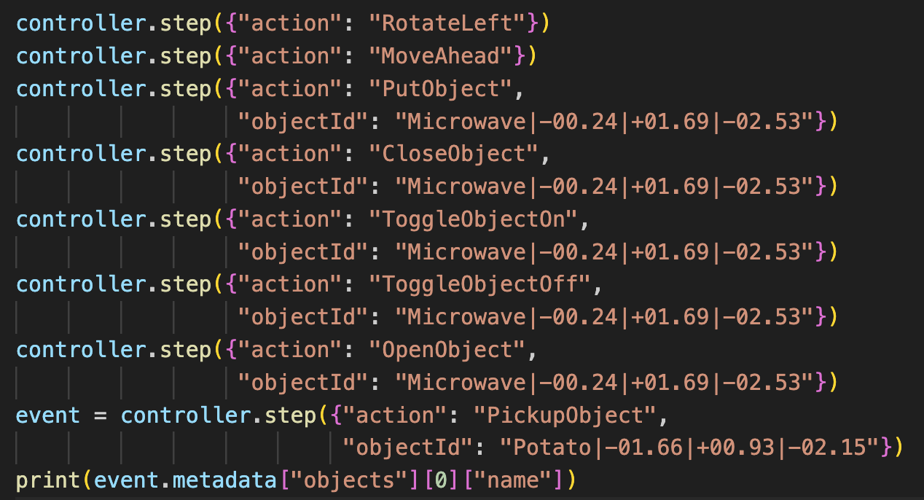
Notes:
Basic actions with no arguments

Slide 5
Notes:
Actions that take an object argument

Slide 6
Notes:
Would print Apple|….|….|….

Slide 7
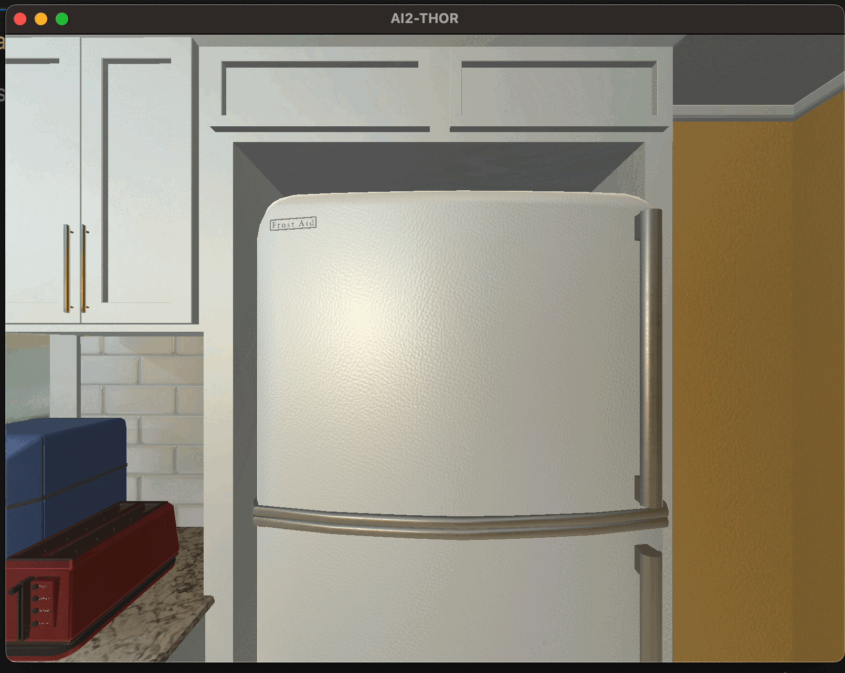
AI2THOR
Notes:
Note the instant changes when picking up potato, toggling microwave, cooking potato
Notice that actions are instantaneous. No conception of time with the iTHOR API.

Slide 8
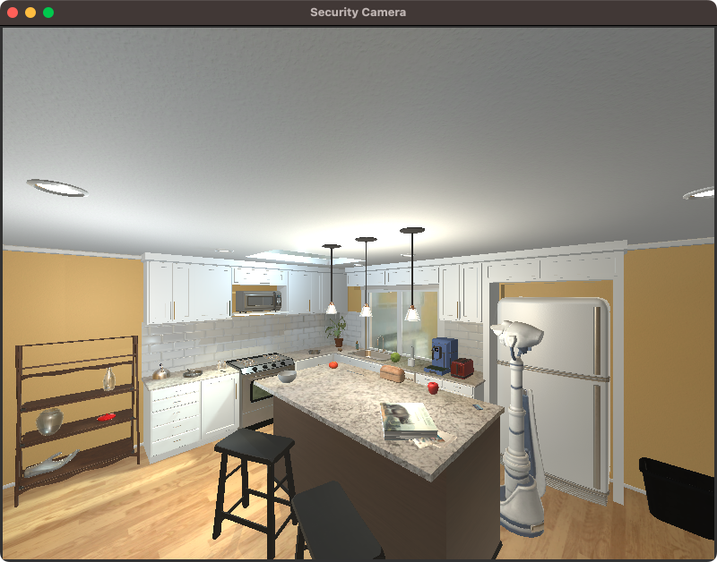

Slide 9
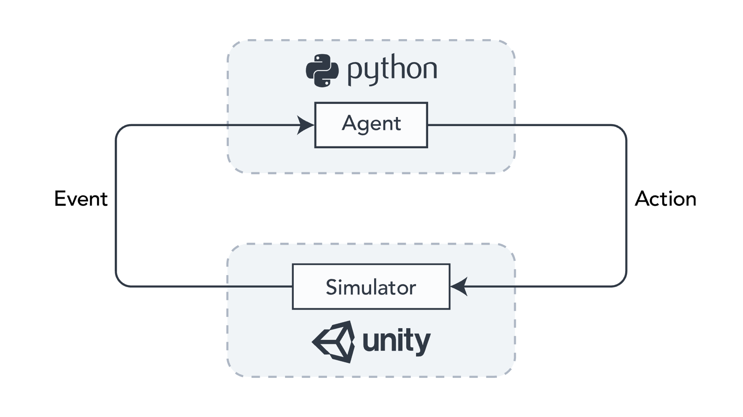
AI2THOR Architecture

Slide 10




AI2THOR Architecture
Client
Server
Notes:
Attributions:
HTTP logo: https://www.flaticon.com/free-icon/http_1276433
Python and C# logos: Wikipedia/Wikimedia Commons

Slide 11
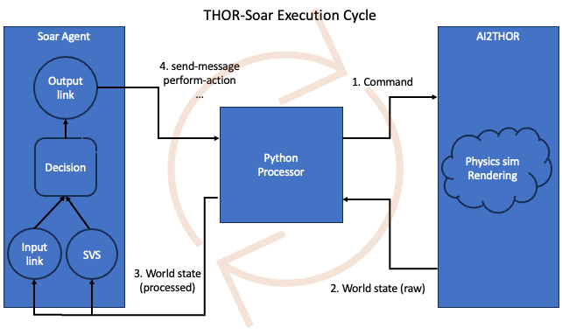
THOR-Soar Architecture

Slide 12
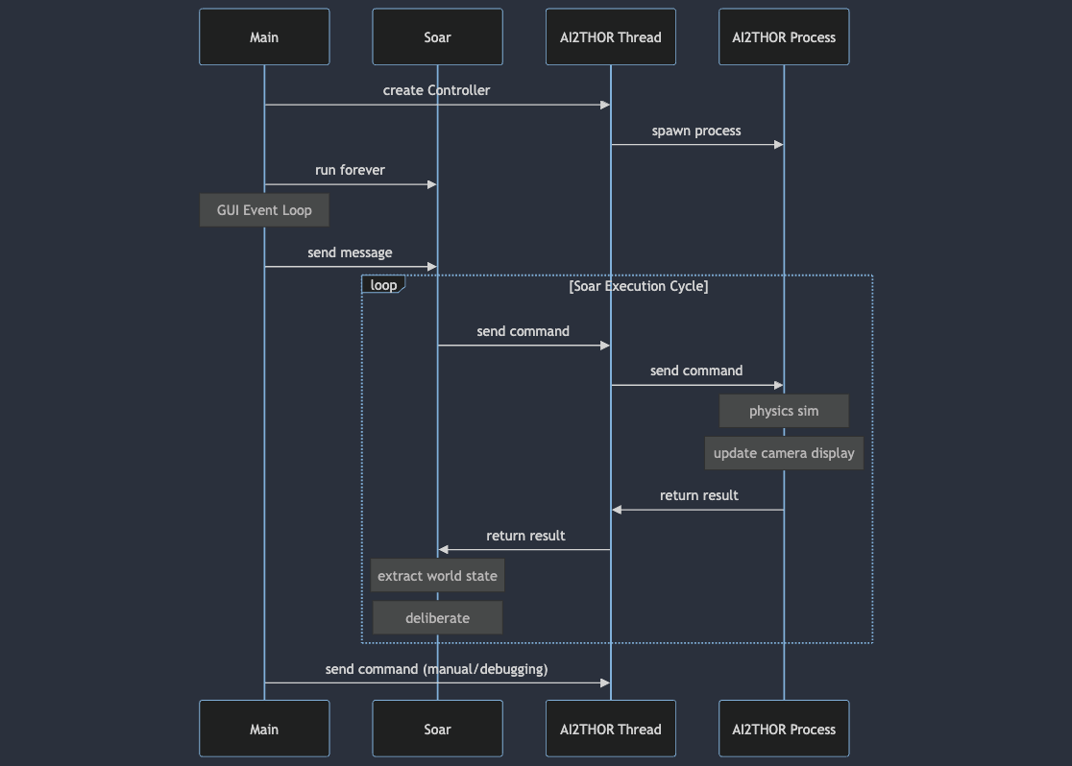

Slide 14
AI2THOR APIs
iTHOR – symbolic actions, rich scenes
ManipulaTHOR – fine-grained motor control and sensing
RoboTHOR – real remote environments
ProcTHOR – JSON-based scenes
Notes:
ManipulaTHOR gives full control of robot hinges (6DOF arm), sensor data
RoboTHOR is about navigating dynamicenvironments, testing real robots
We use iTHOR, which provides mostly symbolic action API (open container, put in container, toggle switch, move)
ProcTHOR is named for “procedural generation”, but it’s also potentially really nice because we can quickly edit scene JSON.
- More machine-writable than human-writable:
- no visual tool - no object browser
- object center coordinates and facing direction are not uniform
- lots of attributes to edit, no documentation on how to put together
- generation script digs into guts, no documentation, very magical
- There are hundreds of available generated scenes, though, so it is possible to filter down to ones with certain parameters (number of rooms, present room types, unique objects, etc.)
- Limited object library. No oven, for example. iTHOR scene items are not usable.

Slide 15
AI2THOR APIs
iTHOR – symbolic actions, rich scenes
ManipulaTHOR – fine-grained motor control and sensing
RoboTHOR – real remote environments
ProcTHOR – JSON-based scenes
Notes:
ManipulaTHOR gives full control of robot hinges (6DOF arm), sensor data
RoboTHOR is about navigating dynamicenvironments, testing real robots
We use iTHOR, which provides mostly symbolic action API (open container, put in container, toggle switch, move)
ProcTHOR is named for “procedural generation”, but it’s also potentially really nice because we can quickly edit scene JSON.
- More machine-writable than human-writable:
- no visual tool - no object browser
- object center coordinates and facing direction are not uniform
- lots of attributes to edit, no documentation on how to put together
- generation script digs into guts, no documentation, very magical
- There are hundreds of available generated scenes, though, so it is possible to filter down to ones with certain parameters (number of rooms, present room types, unique objects, etc.)
- Limited object library. No oven, for example. iTHOR scene items are not usable.

Slide 16
Working Assumptions
Object identification
Motor control
Navigation/environment mapping

Slide 17
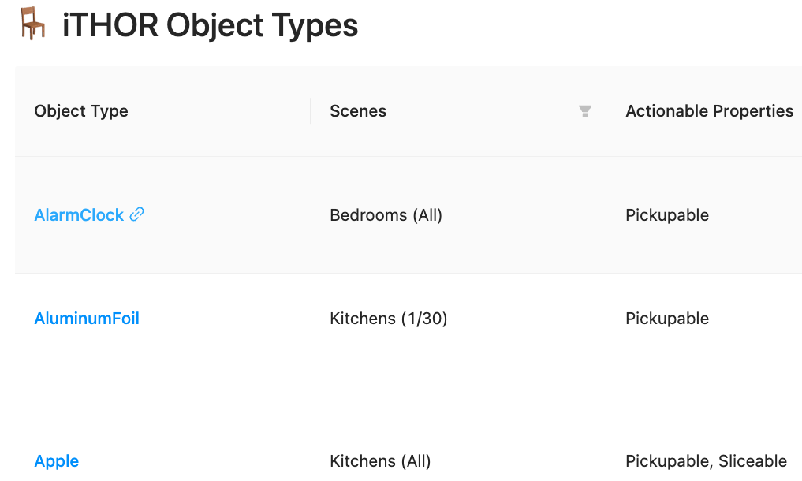
Notes:
https://ai2thor.allenai.org/ithor/documentation/objects/object-types
213 object types
Actually restricts what objects can go in a give container by default

Slide 18
Pysoarlib
Wraps Python SML bindings
Manages:
Registering handlers
I/O
Agent/kernel lifetime
Configuration
https://github.com/Center-for-Integrated-Cognition/pysoarlib
Notes:
Original from Aaron Mininger
Fork is public

Slide 19
Agent Config
Agent source, smem source, open debugger, remote/local
Frustum culling
AI2THOR params like viewing distance

Slide 20
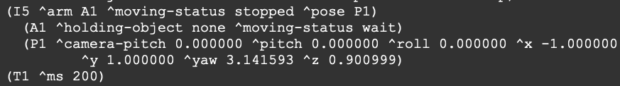
Input Link
Robot’s position and pose
Held object ID
Absolute time

Slide 21
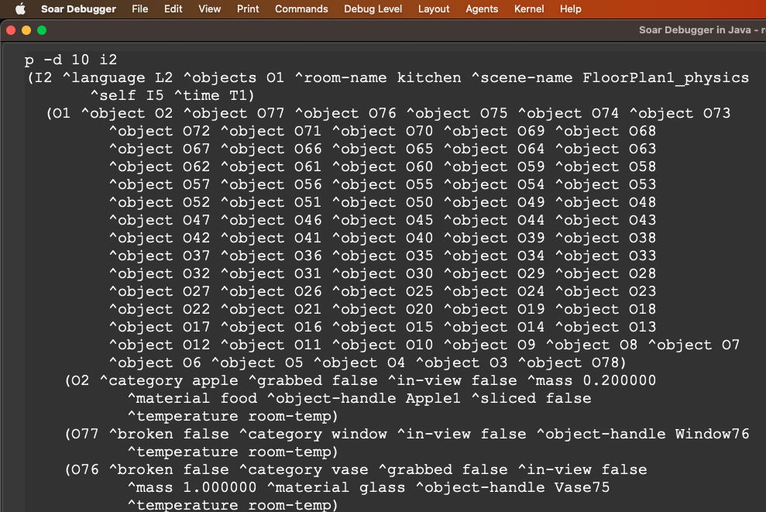
Input Link
Objects:
Location/position
States: open/closed, cooked/raw, on/off
Material name, mass, temperature
Handle
Notes:
Object data is most of what goes on the input link

Slide 22
Object Attributes
Name | Values
category | pot, coffee machine, microwave, …
material | wood, paper, glass, metal, …
mass | [float]
temperature | cold, room-temp, hot
liquid-contents | none, water, coffee, wine
fill-amount | empty, full
ms-remaining | [int]
grabbed | [bool]
Name | Values
activated | [bool]
open | [bool]
broken | [bool]
dirty | [bool]
sliced | [bool]
used-up | [bool]
cook-state | raw, cooked, burnt
in-view | [bool]

Slide 23
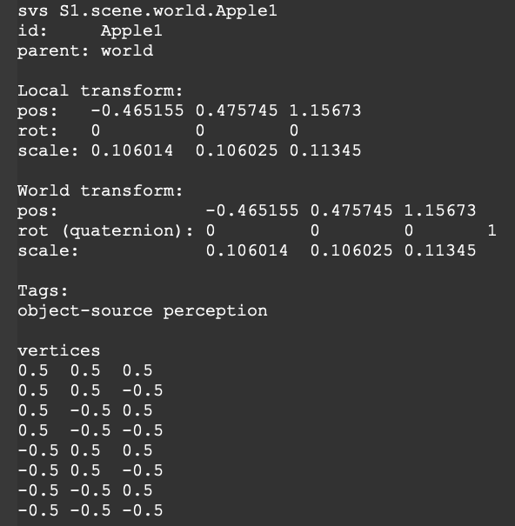
SVS
Notes:
Each object, plus the robot and camera, have SVS meshes associated with them.
Can see via CLI commands, but next slide SVS viewer is easier

Slide 24
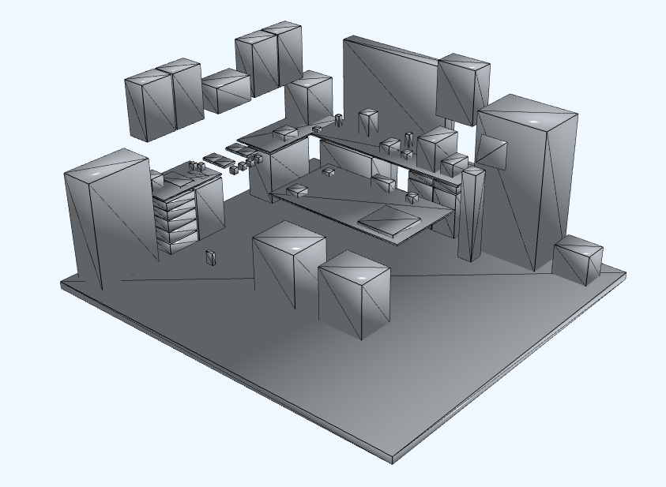
SVS

Slide 25
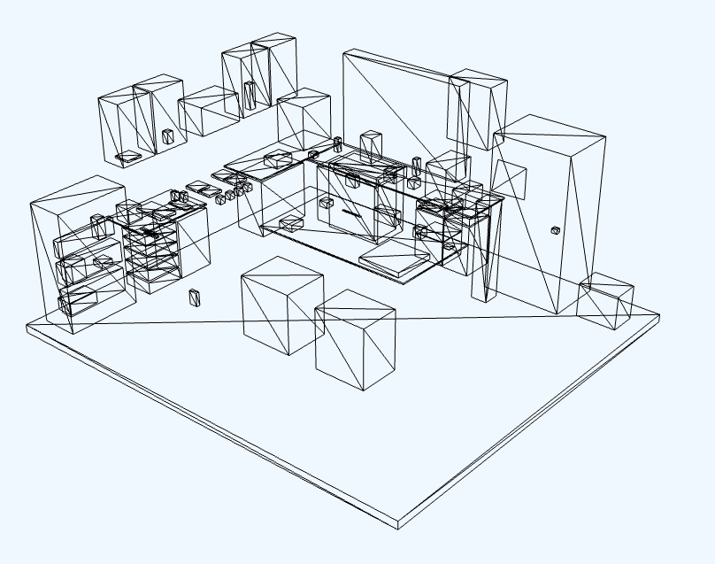
SVS
Notes:
Lots of items inside cabinets, drawers, shelves, the fridge, etc. So lots of exploring to do.

Slide 26

Modeling Time
Missing in iTHOR API 😢
Simulated in Python wrapper
Simulated time passes per action
Simulated time passes per Soar decision cycle
Notes:
Time is there for the ManipulaTHOR API, but iTHOR API uses instantaneous object changes
TODO picture of

Slide 27

Timers and Cooking
Cooking accumulates energy in cooked items
Food is cooked or burnt when energy is accumulated
Coffee maker, toaster, etc. turn off when timer expires
Notes:
Our one timer application right now is cooking, though we may apply it to others like dishwasher washing in the future.
Energy measured in joules

Slide 28

Timers/Cooking Configuration
ms_per_decision_cycle = 50
ms_per_action = 2000
cook_energy_joules = {potato: 15000, bread: 1000, default: 1000}
cook_power_watts = {microwave: 1000, toaster: 250, default: 1000}
burn_tolerance = 0.9

Slide 29
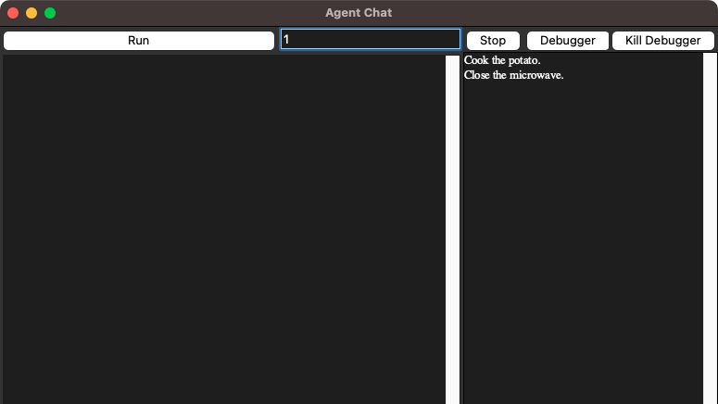

Slide 30
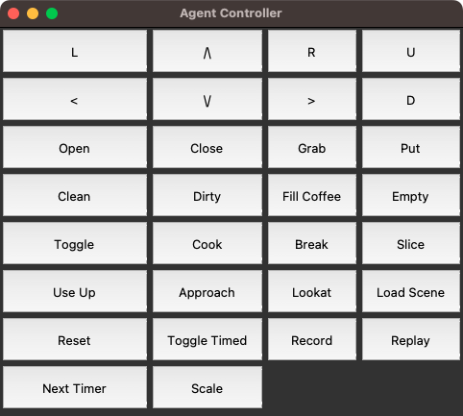

Slide 31
Distribution
Official AI2THOR builds are fully automated
Fork is not so lucky
Build on our machines, upload to GitHub
Change download URL in Python ai2thor package fork
Ask users to update their Python package
Auto-downloads our built binary

Slide 32
Unity Basics
AI2Thor built on Unity and C# scripts (Some Python as well).
(Most) all games objects based on novel defined type: SimObjectPhysics
All objects have unique object IDs.
New objects have been introduced to AI2Thor:
Carrot (and slices)
Soda Can
Dishwasher
Oven
Fully understanding the system has been a work in progress.

Slide 33
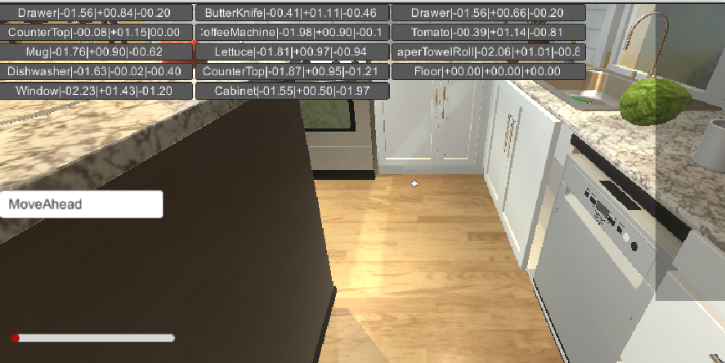
Robot View

Slide 34
Adding Objects
Artwork ($$)
Boundaries (boxes, cylinders, spheres, capsules)
Triggers (more boundary structures)
Receptacle (for objects that can hold other things) (again, more boundary structures)
Visible Points (points that surround the surface of the object)
Action-Specific components that can reference existing (C#) scripts:
Openable
Cookable
Cleanable

Slide 35
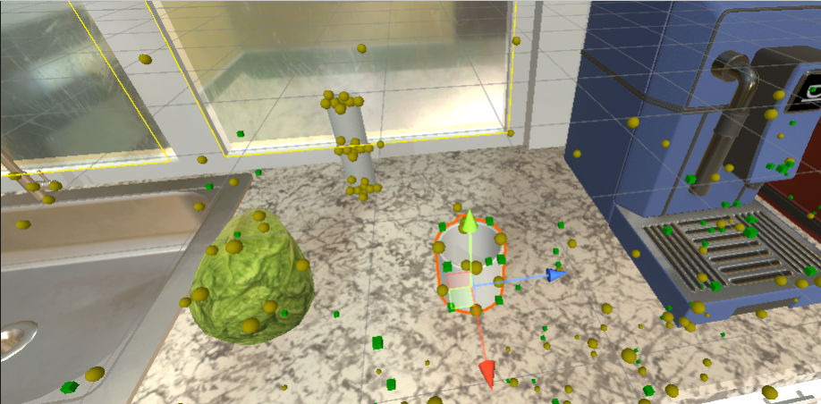
Mesh Layer

Slide 36
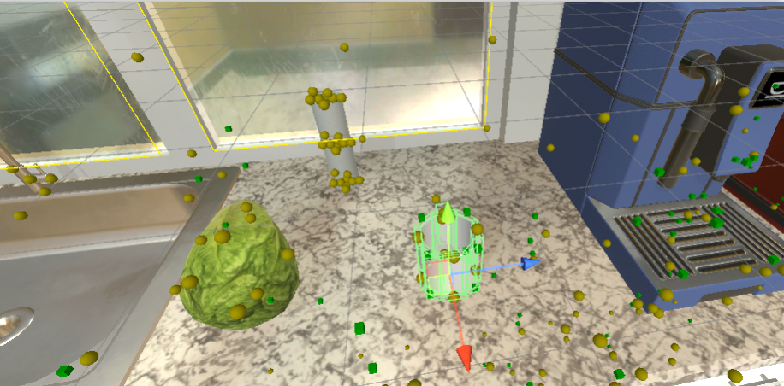
Collisions Layer

Slide 37
Visibility
Objects are considered 'visible' if they are close enough to interact with and faced by robot.
For each visible point, a raycast is created from the robot camera through the point
If ray intersects boundary box, object is considered 'visible’
Collision boxes and list of visible points needed to show 'visiblity' for an object.

Slide 38

Visibility Point

Slide 39
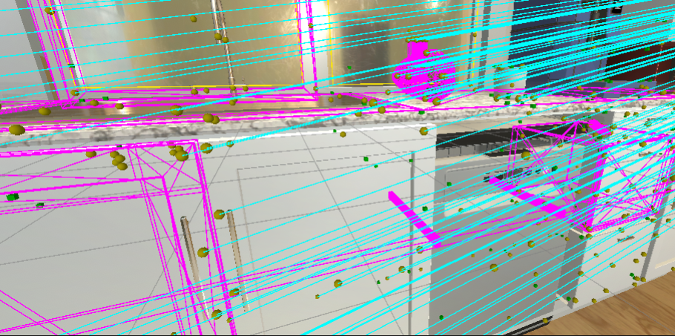
Robot Visibility

Slide 40
Acting on Objects
Action on an Object
To act on an object, a ServerAction class instance is created; assigned with the ObjectID.
Can then be processed:
CleanObject(mySrvrAct);
CookObject(mySrvrAct);

Slide 41


Nuggets and Coal
Looks nice
Interesting planning/interaction domain
World model granularity fits research goals
“Faked” world editing is easy
Difficult build process for forks
Difficult to cross granularities
World editing is complex

Slide 42
Thank you!
Questions and comments are welcome

